Slide 1
Online Examination System(Examsphere)
Fusion Five

Slide 2
Online Examination System
About our Team
Team Name: Fusion five
Project Title: Online Examination System
Course: SIC Coding & Programming
College :RAYAT BAHRA UNIVERSITY,KHARAR(MOHALI)
Batch Code :25037
Team Members & Role:
Ms. ARUSHI KAUSHAL(Team leader)
Mr. Furkan Fayaz(Presentation & Demo)
Mr. Aryan (Data Lead)
Ms. Anjali Sharma(Model Builder)
Mr. Anmol Singh(Research & Testing)

Slide 3
Online Examination System
Problem Statement
The current manual (pen-and-paper) examination system is inefficient and prone
to errors. Key issues include:
High Costs: Large expenses for paper, printing, and logistics.
Time Delays: Grading and result generation take weeks or months.
Security Risks: High chance of question paper leakage and physical tampering.
Human Error: Mistakes in manual marking and data entry for results.

Slide 4
Online Examination System
Objective of the Project
Main Goals: To provide a scalable, tamper-proof platform that automates assessment while
ensuring high security and integrity through user authentication.
Expected Outcomes:
Automated Evaluation: The system will instantly grade objective tests, eliminating human
error and manual labor.
Enhanced Security: Features like randomized question sets and timed sessions will prevent cheating
and unauthorized access.
Data Analytics: Admins will receive comprehensive performance reports and statistical insights into
student progress.
Accessibility: Students can securely take examinations from any location, reducing the need for
physical infrastructure.

Slide 5
Online Examination System
Proposed Solution
The proposed solution is to develop a web-based Online Examination System
that automates the entire examination process, making it more efficient, secure,
and user-friendly. The system will reduce manual work and provide a reliable platform
for conducting exams online.

Slide 6
Online Examination System
System Architecture / Flow Diagram
Our project follows a Three-Tier Architecture based on Django’s MVT pattern.
Presentation Layer (Frontend):
Users: i. Student ii. Teacher iii. Admin
Technologies Used: i. HTML ii.CSS
Functions: i. Login / Registration ii. View dashboard
iii. Attempt exams iv. Create quizzes v. View results

Slide 7
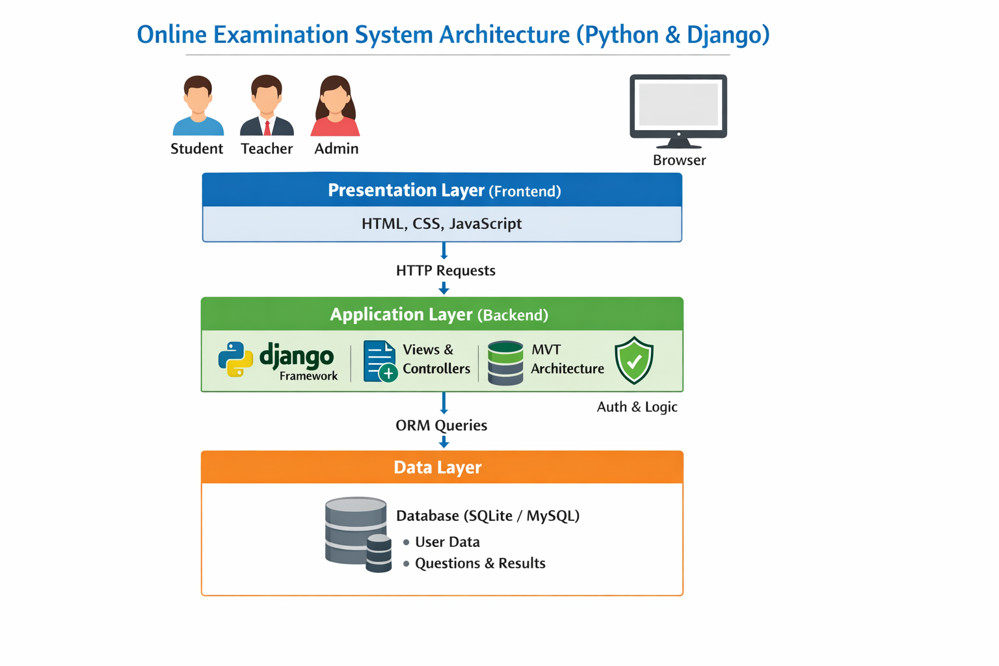
Online Examination System
System Architecture / Flow Diagram
Application Layer (Backend – Django Server)
Technology: Python with Django Framework
Components: Views – Handle user requests
Models – Define database structure
Templates – Display output
URLs – Route requests
Data Layer (Database)
This layer stores all system data securely.
Database: SQLite
Stores: User details
Questions & answers
Exam records
Results
Login history
Examination System
n System

Slide 8
Online Examination System
Tools, Technologies & Libraries
Programming Language – Python
We have used Python as the main programming language.
It is easy to understand, powerful, and widely used for web development.
Python helps in writing clean and efficient backend logic.
Web Framework – Django
Django is used to develop the web application.
It helps in faster development and provides built-in security features
Django manages:
  User authentication (Student, Teacher, Admin)
  Database handling
  Form processing
  URL routing

Slide 9
Online Examination System
Tools, Technologies & Libraries
Frontend Technologies – HTML, CSS, JavaScript\
    HTML is used to create the structure of web pages.
    CSS is used for designing and layout.
    JavaScript is used for validation and dynamic behavior (like timers, alerts, etc.).
Database – SQLite
We used SQLite (default Django database) for storing data.
It stores:
i. User details
ii. Questions
iii. Answers
iv. Results
Development Tools
VS Code– For coding
Git – For version control
Browser – For testing (Chrome/Edge)

Slide 10
Online Examination System
Dataset Description
The dataset used in our project is stored in a relational database (SQLite/MySQL) and is managed using Django ORM. It contains structured data related to users, exams, questions, and results
User Dataset:This table stores information about all system users.
Attributes:
Name
Password (Encrypted)
Role (Student / Teacher / Admin)
Registration Dat
Student Dataset:
Attributes : Stores academic and exam-related data of students.
Student ID
User ID (Foreign Key)
Course / Class
Exam ID
Attempt Status

Slide 11
Online Examination System
Dataset Description
Teacher Dataset:
Attributes:
Teacher ID
Subject
Department
Exam Dataset:
Attributes:
Exam Title
Subject
Total Marks
Created By (Teacher ID)
Question Dataset
Attributes:
Question Text
Option A, B, C, D
Correct Answer
Marks

Slide 12
Online Examination System
Methodology / Implementation Steps
1. Coding Logic
Users log in based on role (Admin/Teacher/Student).
Teacher creates exams and adds questions.
Student attempts exam within given time.
System saves answers automatically.
Answers are evaluated and result is generated
2. Algorithm Used
Authentication Algorithm (for login)
Random Shuffle Algorithm (for questions)
Timer Algorithm (for exam time)
Evaluation Algorithm (for scoring)
Role-Based Access Control (for security)
3. Flow of Code Modules
User Module: Login/registration
Exam Module: Create and manage exams
Question Module: Store questions
Submission Module: Save student answers
Evaluation Module: Check answers
Result Module: Display results
User Module → Exam Module → Question Module → Submission Module → Evaluation Module → Result Module

Slide 13
Online Examination System
Results & Performance
Result / Final Outcome
Successfully developed a web-based online examination system.
Implemented secure login for Student, Teacher, and Admin.
Teachers can create and manage quizzes.
Students can attempt exams within a given time.
Automatic evaluation and result generation.
Reduced manual work and paperwork.
Improved speed and accuracy of examinations.
Key Findings
Online exams save time and resources.
Automated evaluation reduces human errors.
Django provides strong security and reliability.

Slide 14
Online Examination System
Results & Performance
Challenges Faced
Implementing secure authentication system.
Preventing multiple submissions.
Debugging backend logic.
Integrating frontend with backend.
Future Scope
Mobile application integration.
AI-based cheating detection..
Performance analytics.
Multi-language support.
Integration with Learning Management Systems (LMS).

Slide 15
Online Examination System
Results & Performance
Features to be Added
Live video monitoring during exams.
Question randomization.
Auto-save answers.
Resume exam feature.
Detailed performance reports.
Certificate generation.
Notification system.
Offline exam mode.

Slide 16

Thank You
Open for questions
Samsung Innovation Campus

